Slide 1
6.1 Using Fundamental Identities
Lesson objectives: I can use trig identities to
Simplify trig expressions
Rewrite trig expressions

Slide 3
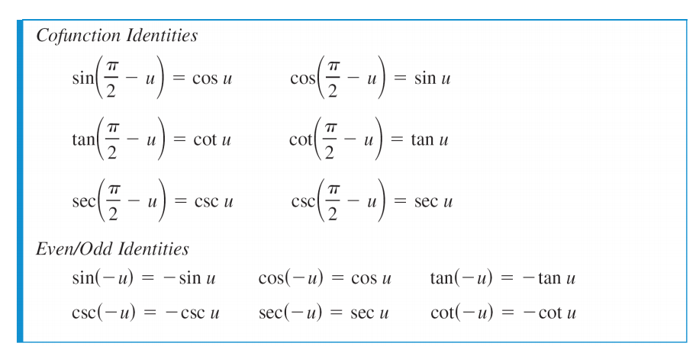

Slide 4
Simplifying Trig expressions
Seems to mean to write it in terms of a single trig function without fractions.
Sometimes it can only be simplified into terms of two trig functions.

Slide 5
Strategies
Lots of substitution
Using different variations of the Pythagorean identitie
Ex: sin² x + cos² x = 1 also means...
Factoring
Multiplying by different forms of 1

Slide 6
Simplify each expression.
1. cot x sin x

Slide 7
sin u(csc u – sin u)

Slide 8
3. $\frac{\csc{x}}{\cot{x}}$

Slide 9
$sec β∙\frac{\sin{β}}{\tan{β}}$

Slide 10
5. $\sin\left(\frac{π}{2}−x\right)\csc{x}$

Slide 11
6. $\frac{\cos^{2}y}{1 −\sin{y}}$

Slide 12
Factor and use fundamental identities to simplify.
7. sin x cos² x – sin x

Slide 13
8. cos² x csc x – csc x

Slide 14
9. $\frac{\cos^{2}x −4}{\cos{x −2}}$

Slide 15
9. tan⁴ x + 2 tan² x + 1

Slide 16
10. sin⁴ x – cos⁴ x

Slide 17
11. csc³ x – csc² x – csc x + 1

Slide 18
Add or subtract as indicated and use fundamental identities to simplify.
12. $\frac{1}{1+\cos{x}}+\frac{1}{1−\cos{x}}$

Slide 19

13. $\tan{x − \frac{\sec^{2}x}{\tan{x}}}$

Slide 20
Rewrite the expression so that it is not in fractional form.
14. $\frac{\sin^{2}y}{1−\cos{y}}$

Slide 21
15. $\frac{3}{\sec{x −\tan{x}}}$

Slide 22
Closing Activity: SNOWSTORM
On a sheet of scratch paper, write down one concept you have learned today or write about what skill you think you have improved upon or learned in today’s lesson. Then ball it up, and throw it in the air.

