Slide 1
Thursday, January 26th
Welcome to Day 2 of ICM!!
Take out your syllabus and calculator contracts.
Take out your homework and your homework stamp page!
Compare your homework answers with your teammates and the answer key. Discuss solutions. (10 minutes)
#9b was supposed to be 19b. The answer to 9b is false.

Slide 2
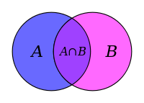
6.2 The Number of Elements in a Finite Set

Slide 3
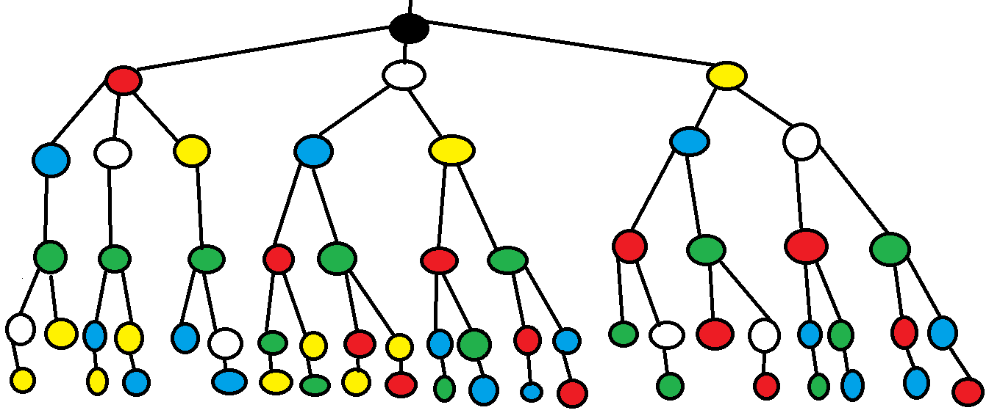
What is combinatorics?
A branch of math that involves the study of enumerations, combinations, and permutations of finite (countable) sets.

Slide 4
Notation: n(A) = the # of elements in set A
Ex: 1 A = {2, 4, 6, 8} n(A) =
B = {1, 2, 3, …, 30} n(B) =

Slide 5
Ex 2: A = {a, b, c, d, e} B = {d, e, f, g, h, i, j}
Find A $∪$ B
Find A $∩$ B
Now find each of the following:
n(A $∪$ B)= n(A) = n(B) = n(A $∩$ B) =
Mathematically, how can you get n(A $∪$ B) from the other values?

Slide 6
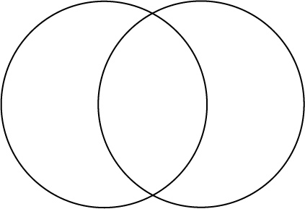

Slide 7
n(A $∪$ B) = n(A) + n(B) – n(A $∩$ B)
If n(A $∩$ B) = 0, then A and B are disjoint and n(A $∪$ B) = n(A) + n(B).

Slide 8
Ex 3: In a survey of 120 customers, 80 buy Dawn, 68 buy Joy, and 42 buy both.
How many buy at least one brand?
Exactly one brand?
Only Dawn?
Neither brand?

Slide 9
Team Activity: Lesson 6.2 You try! ☺
Be ready to present your answers to the class!
(I will randomly select students to present.)
Facilitator (1): Moderates team discussion, distributes work
Timekeeper(2): Keeps group aware of time constraints. (10 minutes)
Checker (3): Check in with other groups or teacher key, checks to make sure all group members understand concepts and conclusions
Prioritizer (4): Makes sure group stays focused and on-task

Slide 10

Let n(U) =100, n(A) = 60, n(B) = 40, and n(A$∩$B) = 20. Find each of the following.
a) n(A $∪$ B)
b) n(A $∩$ B^{c})
c) n(A^{c} $∩$ B)

Slide 11
In a survey of 1000 families, it was found that 900 own at lease one DVD player, 240 own at least one Blue Ray player, and 160 own both.
a) How many own DVD players only?
b) How many own neither?

Slide 12
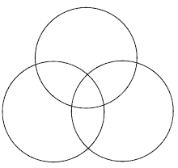
n(A $∪$ B $∪$ C) = n(A) + n(B) + n(C) – n(A $∩$ B) – n(B $∩$ C) – n (A $∩$ C) + n(A $∩$ B $∩$ C)

Slide 13
Example 4: In a survey of 100 people at a carnival:
40 like cotton candy
30 like popcorn
45 like lemonade
15 like lemonade and popcorn
10 like cotton candy and lemonade
12 like cotton candy and popcorn
5 like all three
How many people don’t like lemonade, popcorn, or cotton candy?
How many people only like popcorn?

Slide 14
Example 5: In a survey of 200 people regarding their investments, the following data were obtained:
141 had investments in stocks
91 in bonds
60 in money markets
47 in stocks and bonds
36 in stocks and money markets
36 in bonds and money markets
5 in some other vehicle
How many had investments in all three types?
How many had investments in stocks only?

